Slide 1
A Supervised Tensor Dimension Reduction-Based Prognostics Model for Applications with Incomplete Imaging Data
Chengyu Zhou
Joint work with Dr. Xiaolei Fang
Edward P. Fitts Department of Industrial and Systems Engineering
North Carolina State University

Slide 2
Outline
Motivation and Challenge
Proposed Methodology
Modeling construction
Parameter estimation
Closed-form solutions
Simulation and Case Studies
Summary

Slide 3
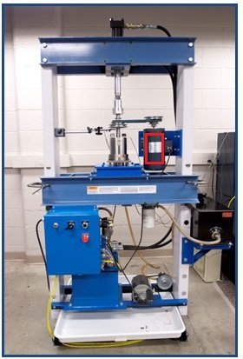
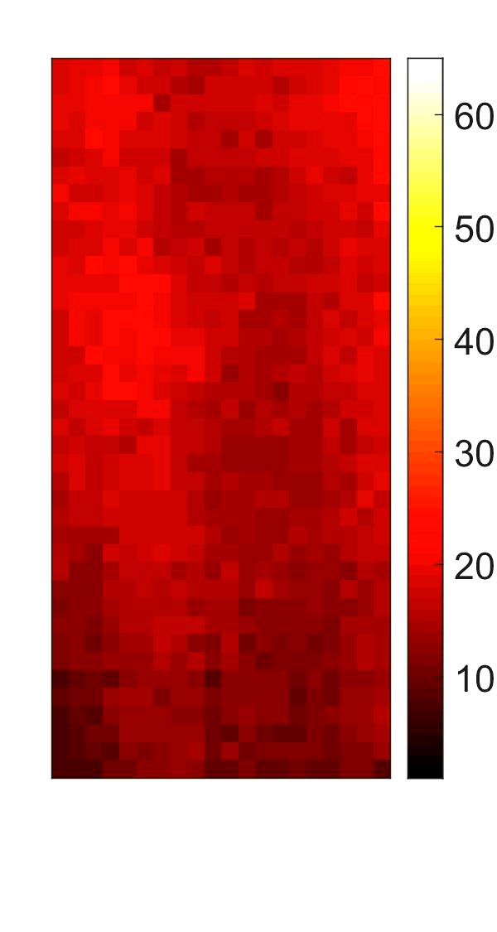
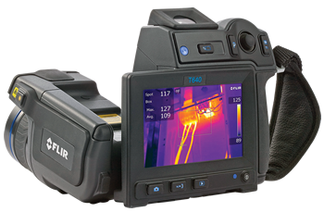
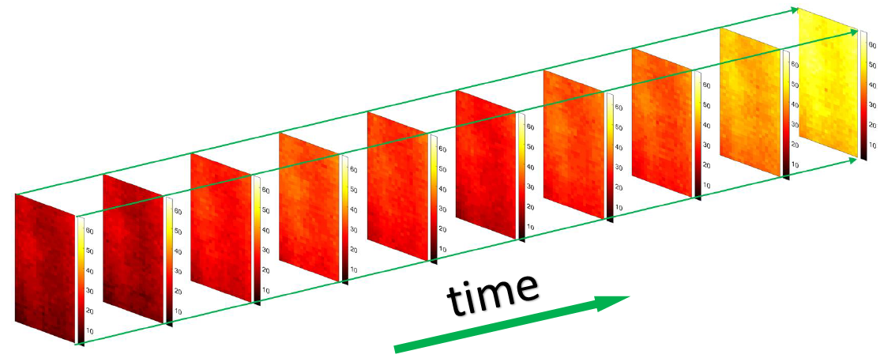
Motivation
A growing trend of using image sensing techniques for condition monitoring as they are noncontact and contain richer information
A degradation image stream is an image stream that contains the degradation information of a system

Slide 4
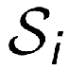
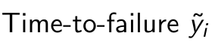
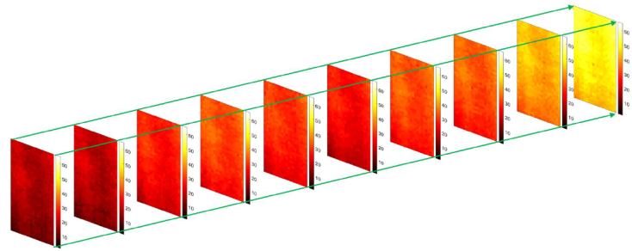
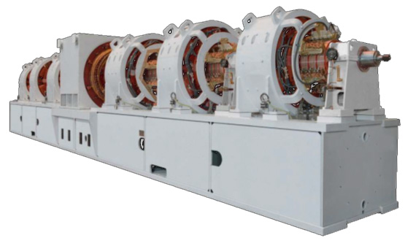
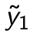
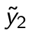
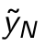
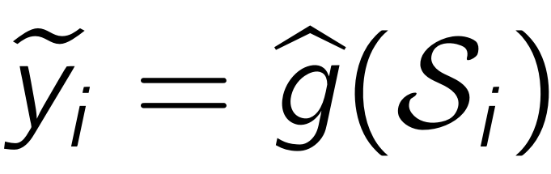
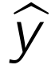
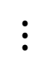
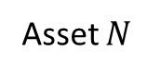
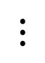
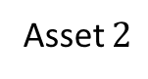
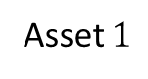
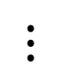
Objectives
Asset $1$
Historical
Signals
Asset $2$
$$⋮$$
$$⋮$$
$$⋮$$
Asset $N$
Real-Time Signals

Slide 5
Literature Review
 | Existing methods | Limitations
Deep Learning | Aydemir and Paynabar (2019) Yang et al. (2021) Dong et al. (2021) Jiang et al. (2022) …… | Only provide point estimates of failure times Cannot be used for subsequent decision-making analysis such as maintenance optimization
Statistical Learning | Liu, Yeo, and Kalagnanam (2016) Fang et al. (2019) …… | No guarantee for effective feature extraction Cannot work for missing data

Slide 6
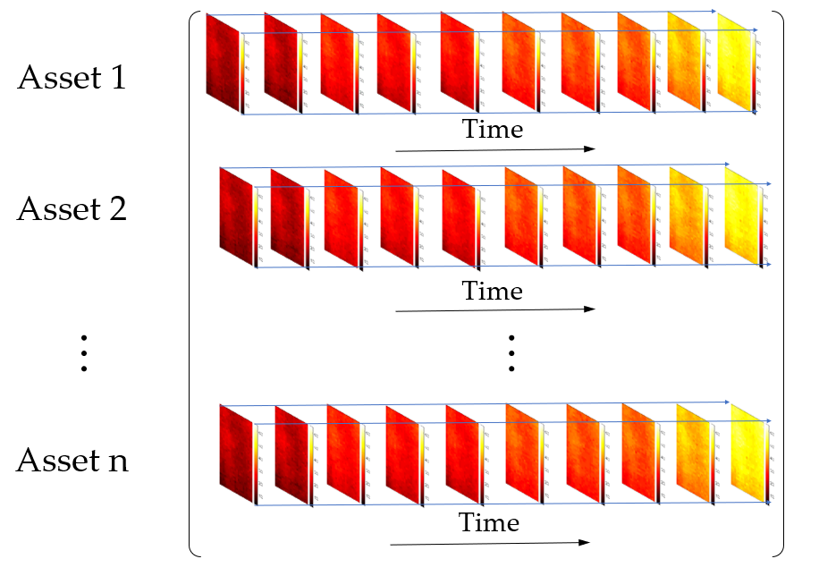
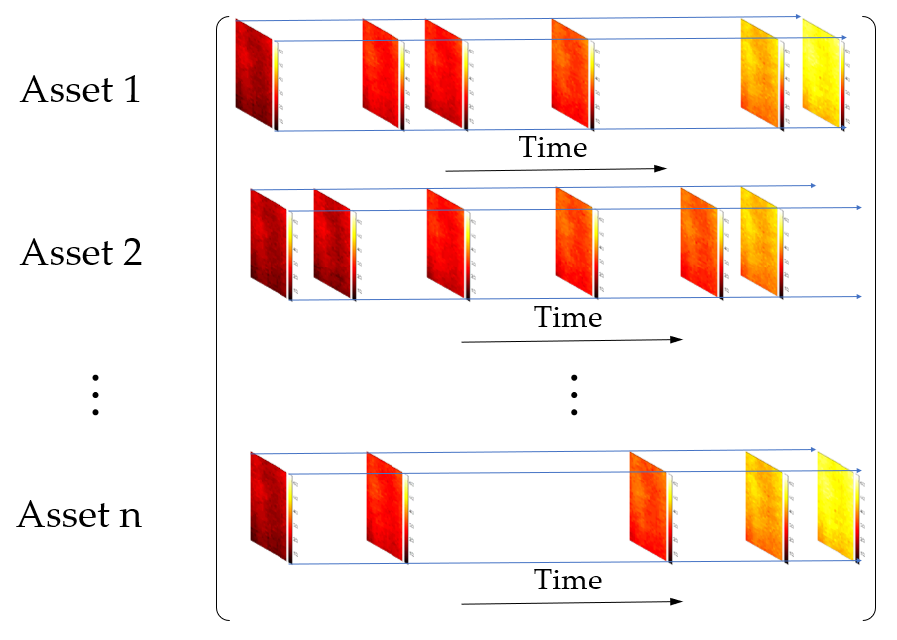
Challenges and Solution
Challenge I: Effective Feature Extraction
Dimension reduction and TTF prediction are separate
Extracted features may not be effective for TTF prediction
Challenge II: Missing Data
Fig. Complete Data Fig. Incomplete (missing) Data

Slide 7
Challenges and Solution
Solution: Supervised Tensor Dimension Reduction-Based Prognostic Modeling with Incomplete Imaging Data
Advantages:
Dimension reduction process is supervised by historical TTFs which guaranteed the effective feature extraction
Work for both complete and incomplete degradation image streams
Step I(A). Supervised Low-Dimensional Tensor Subspace Detection
Step I. Supervised Dimension Reduction
Step I(B). Feature Extraction
Step II. Tensor Regression

Slide 8
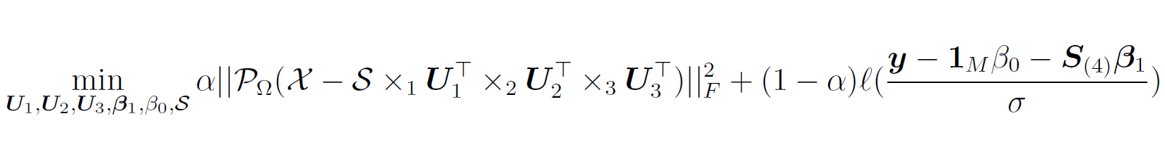
The Model
Step I(A): Supervised Low-Dimensional Tensor Subspace Detection
Historical Tensors
(image streams)
Low-Dimensional Features
Historical TTF
Tensor Dimension Reduction
(Feature Extraction)
LLS Regression
Basis Matrices of the Low-Dimensional Tensor Subspace
LLS Regression includes a variety of TTF distributions, such as (log)normal, (log)logistic, smallest extreme value, and Weibull, etc., which cover most of the TTF distributions in reality.

Slide 9
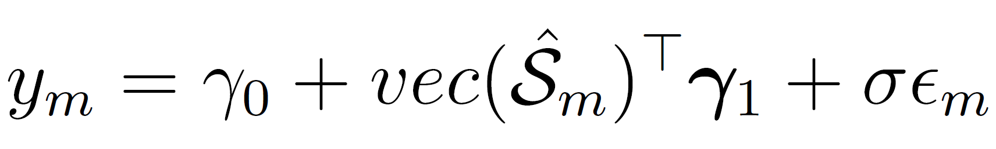
The Model
Step I(B): Feature Extraction
Step II: Construct Prognostic Model
Historical Tensors (image streams) of Asset m
Basis Matrices from Step I(A)
Historical TTF of Asset m

Slide 10


Parameter Estimation
Steps I(B) and II: No need to discuss
Step I(A): Supervised Low-dimensional Tensor Subspace Detection
Reparametrize to be a block-convex problem
Block Updating Algorithm
Step I(A). Supervised Low-Dimensional Tensor Subspace Detection
Step I. Supervised Dimension Reduction
Step I(B). Feature Extraction
Step II. Tensor Regression

Slide 11
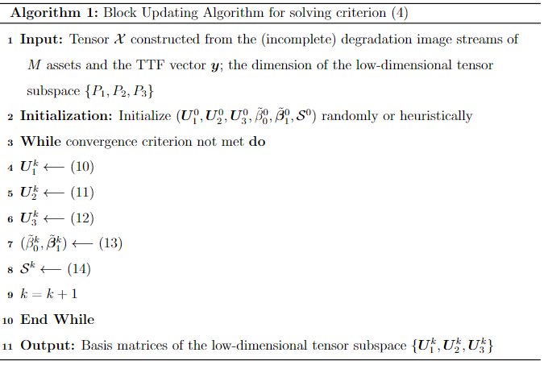
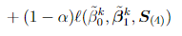
Parameter Estimation
Convergence Property: The block updating algorithm converges to a stationary point with any initialization.

Slide 12
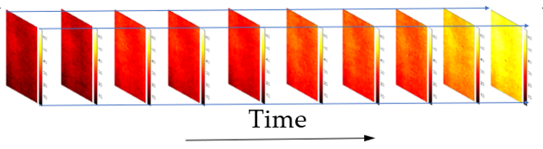
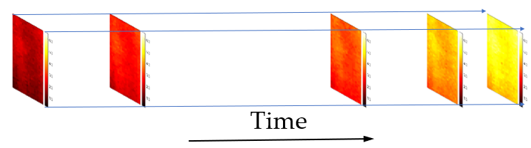
Closed-Form Solutions
When the TTF follows a Normal (or Lognormal) distribution, we have analytical solution for each of the sub problems
I. Complete Data
II. Incomplete (missing) Data
II(A). Entry(Pixel)-wise missing
II(B). Image-wise missing

Slide 13
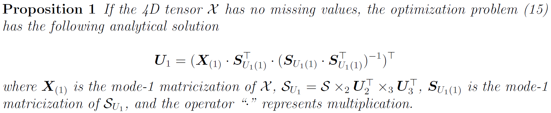
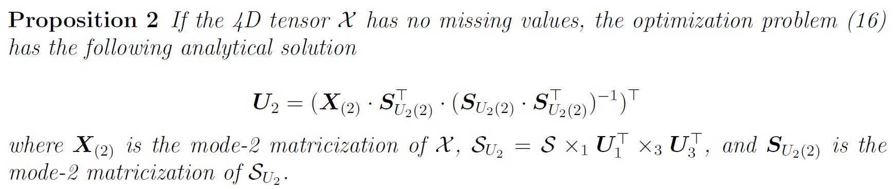
Closed-Form Solutions - I.Complete Data
I. Complete Data

Slide 14
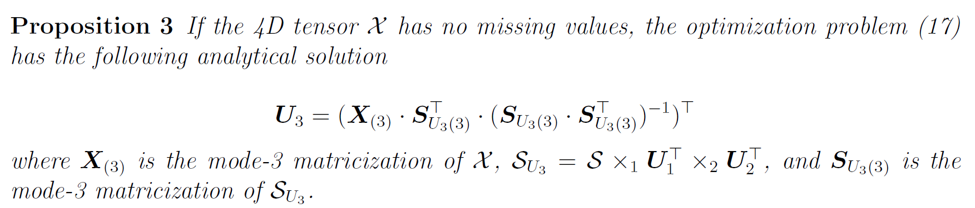
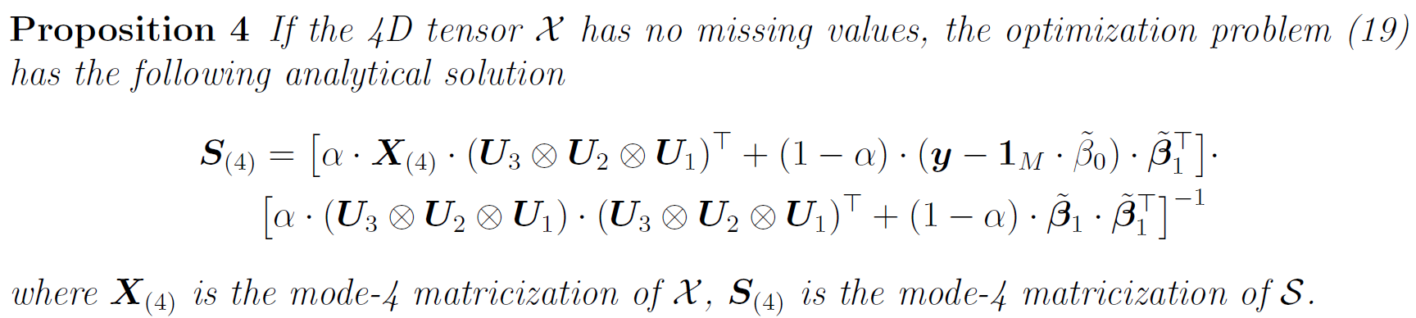
Closed-Form Solutions - I.Complete Data
I. Complete Data

Slide 15
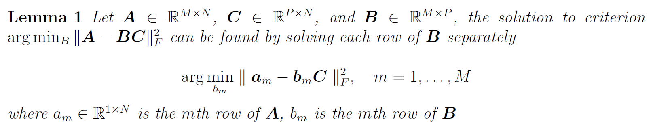
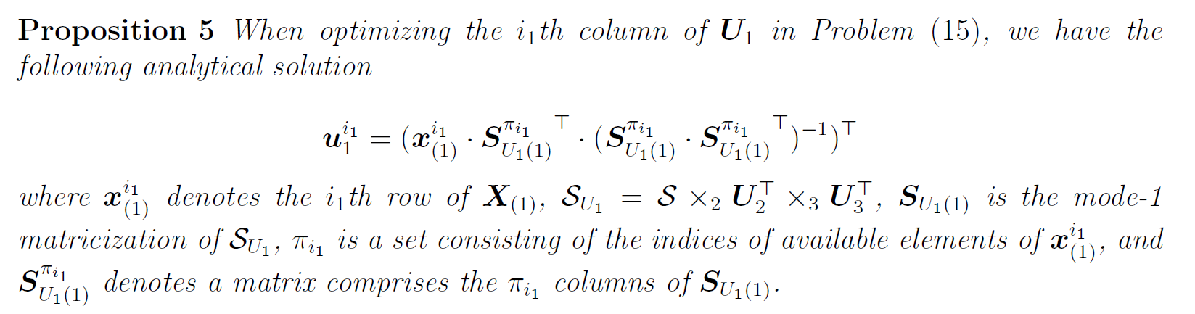
Closed-Form Solutions - II.Missing Data
II(A). Entry-wise missing: Any pixel of the image tensor can be missing

Slide 16
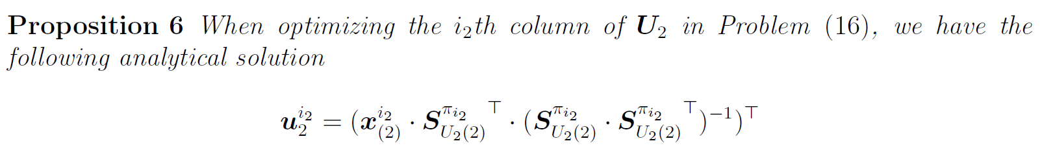
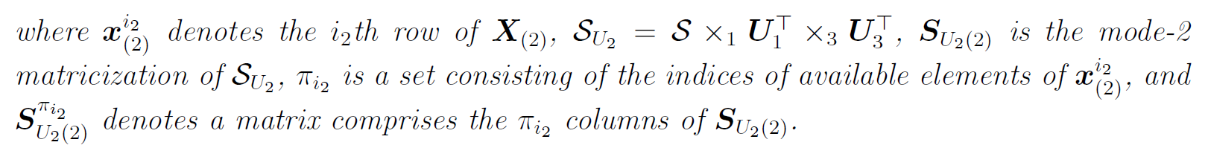
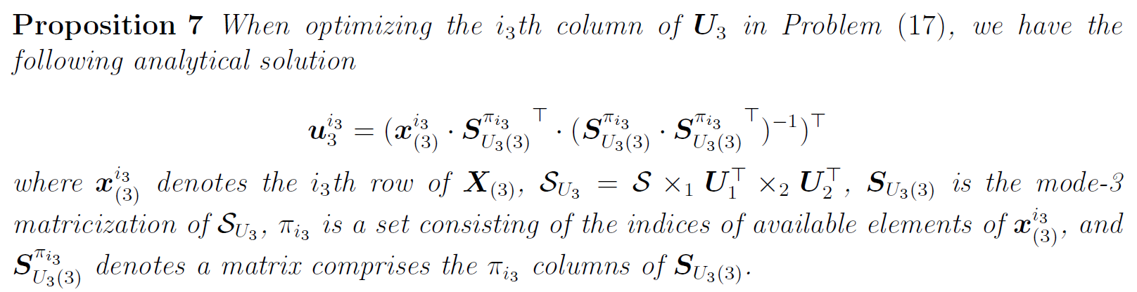
Closed-Form Solutions - II.Missing Data
II(A). Entry-wise missing: Any pixel of the image tensor can be missing

Slide 17
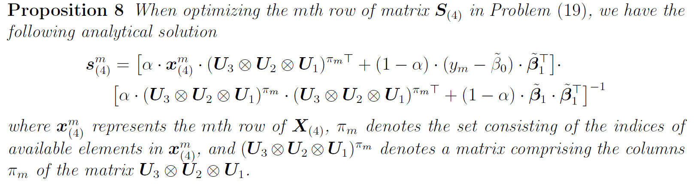
Closed-Form Solutions - II.Missing Data
II(A). Entry-wise missing: Any pixel of the image tensor can be missing

Slide 18
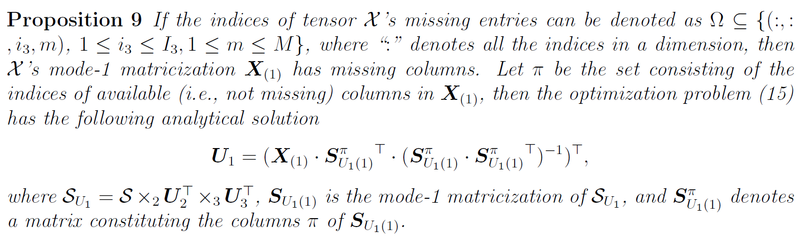
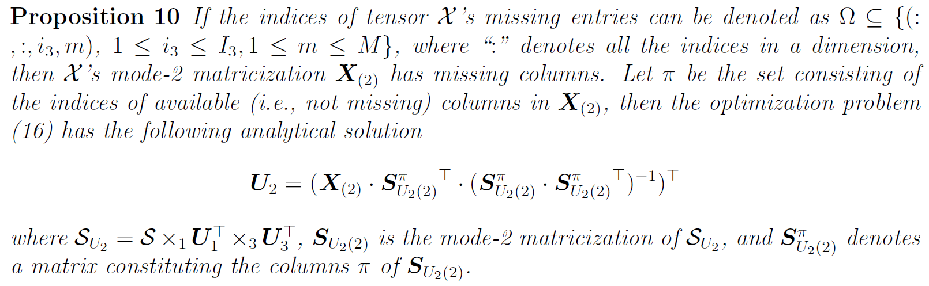
Closed-Form Solutions – II. Missing Data
II(B). Image-wise missing

Slide 19

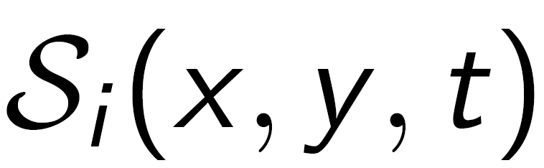
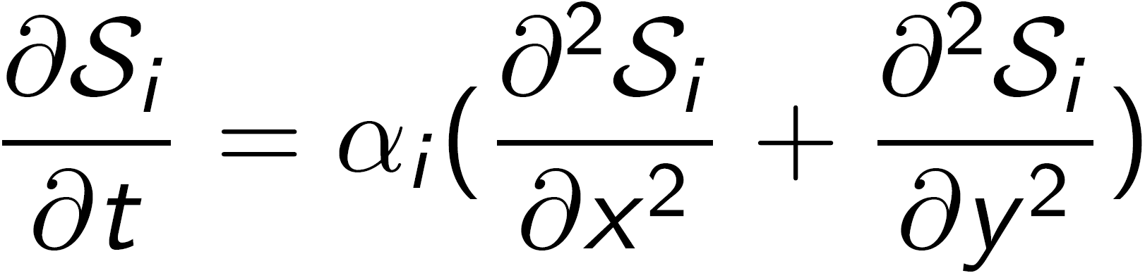

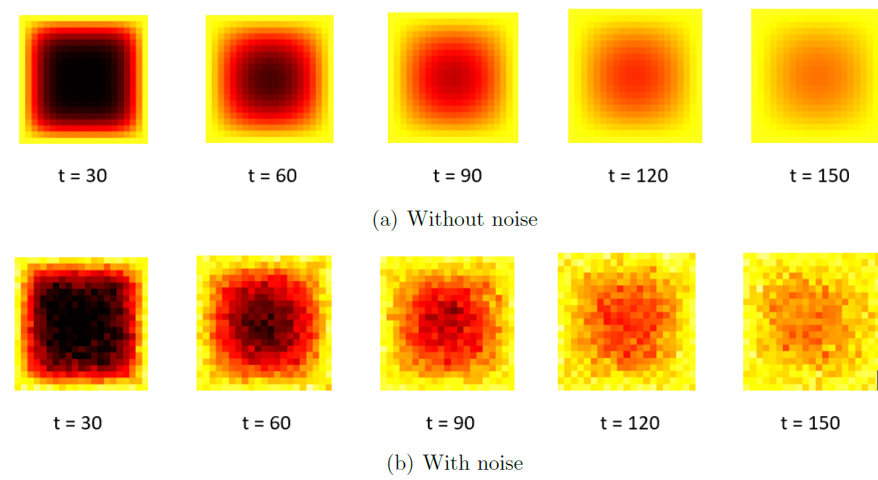
Simulation Study
For system , its image stream, , is generated from the following heat transfer process:
Thermal diffusivity coefficient:
Noise: i.i.d. are added to each pixel

Slide 20
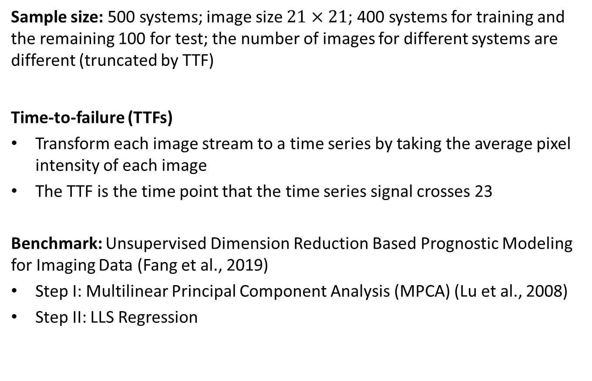
Simulation Study
Sample size: 500 systems; image size $21×21$; 400 systems for training and the remaining 100 for test; the number of images for different systems are different (truncated by TTF)
Time-to-failure (TTFs)
Transform each image stream to a time series by taking the average pixel intensity of each image
The TTF is the time point that the time series signal crosses 23
Benchmark: Unsupervised Dimension Reduction Based Prognostic Modeling for Imaging Data (Fang et al., 2019)
Step I: Multilinear Principal Component Analysis (MPCA) (Lu et al., 2008)
Step II: LLS Regression

Slide 21
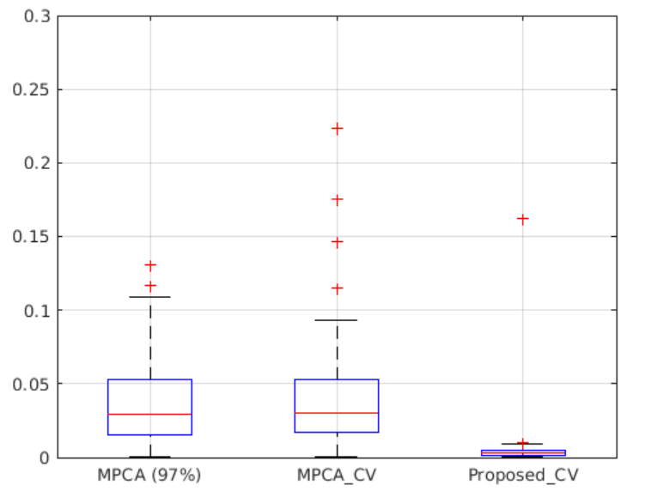
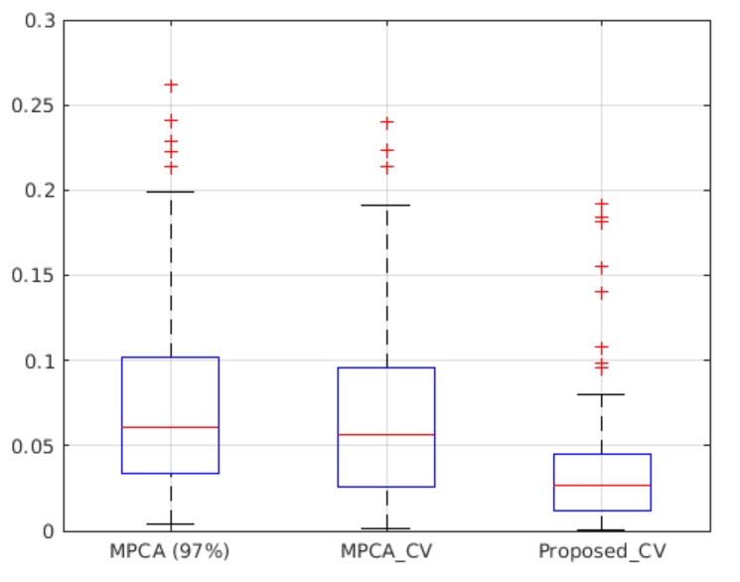
Results (Simulation Study)
Our proposed method outperforms the two benchmarks under all data missing rates.
With the increase of missing rate, the performance of all the 3 models decreases.
‘MPCA_CV’ always outperforms ‘MPCA (97%)’ and the superiority increases with the increase of missing rates.
0% missing
10% missing

Slide 22
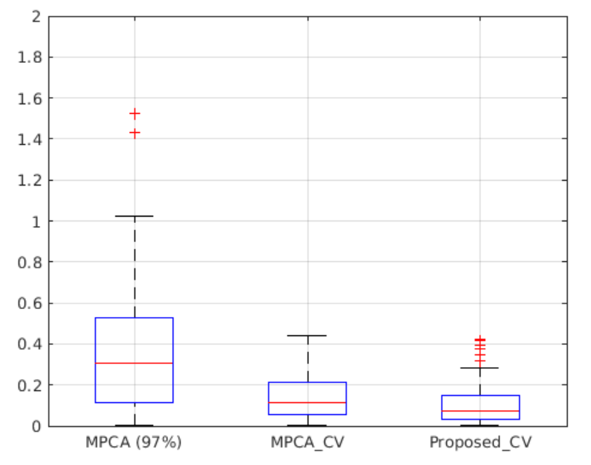
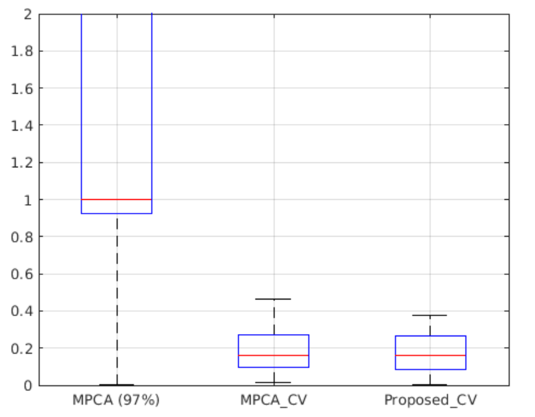
Results (Simulation Study)
Our proposed method outperforms the two benchmarks under all data missing rates.
With the increase of missing rate, the performance of all the 3 models decreases.
‘MPCA_CV’ always outperforms ‘MPCA (97%)’ and the superiority increases with the increase of missing rates.
50% missing
90% missing

Slide 23
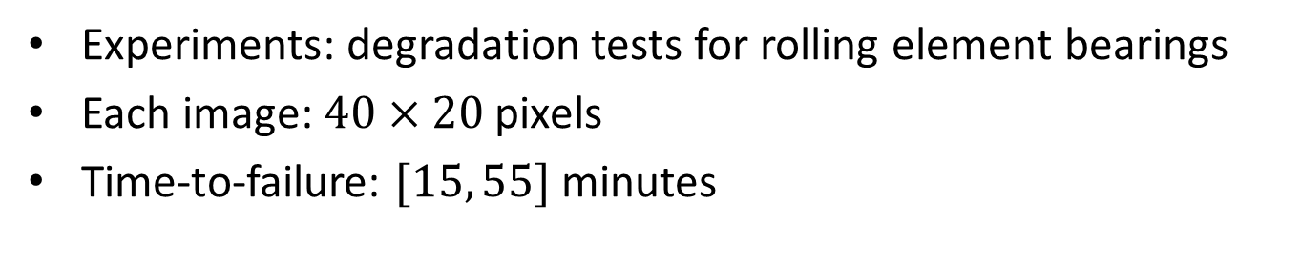
Case Study
Experiments: degradation tests for rolling element bearings
Each image: $40×20$ pixels
Time-to-failure: $[15, 55]$ minutes

Slide 24
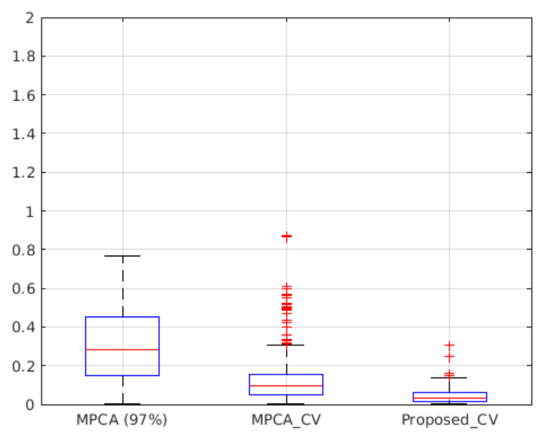
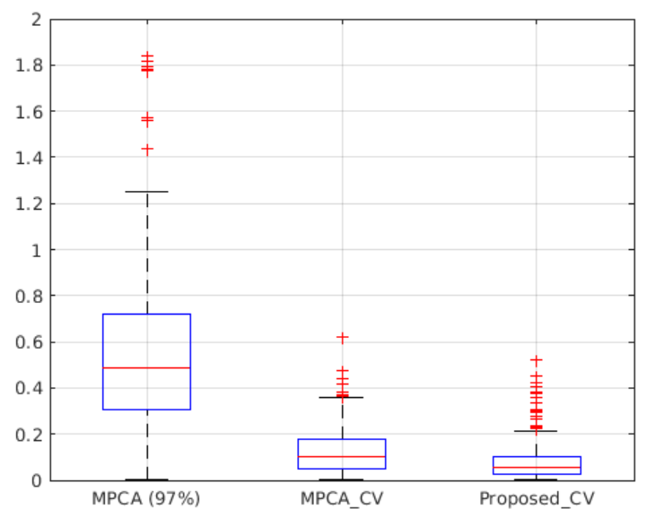
Results (Case Study)
Our proposed method outperforms the two benchmarks under all data missing rates.
With the increase of missing rate, the performance of all the 3 models decreases.
‘MPCA_CV’ always outperforms ‘MPCA (97%)’ and the superiority increases with the increase of missing rates.
0% missing
10% missing

Slide 25


Results (Case Study)
Our proposed method outperforms the two benchmarks under all data missing rates.
With the increase of missing rate, the performance of all the 3 models decreases.
‘MPCA_CV’ always outperforms ‘MPCA (97%)’ and the superiority increases with the increase of missing rates.
50% missing
90% missing

Slide 26
Summary and Conclusions
A Supervised Tensor Dimension Reduction-Based Prognostic Model was proposed
A general optimization algorithm was developed
Closed-Form solution when the TTF is from a Normal/Lognormal distribution was discussed
Simulation and case studies were performed
The results indicated that the proposed supervised dimension reduction-based model outperformed unsupervised dimension reduction-based benchmarks in terms of both prediction accuracy and precision

Slide 27



